Slide 1
Data Structures
Programming Project #1

Slide 2
Data Center
A data center consists of multiple severs
The servers are connected by switches in a local area network

Slide 3
Servers in Data Centers
Rack servers and blade serve
Pros and cons
http://techgenix.com/tower-vs-rack-vs-blade-servers/
https://www.racksolutions.com/news/data-center-optimization/blade-server-vs-rack-server/
Notes:
Rack 機架式較便宜，適合中小型企業、研究單位，散熱管理較容易，每一片 server 安裝在機架中，並連結 switches
Blade 刀鋒式較昂貴，集中式高密度的計算單元，支援熱插拔，散熱較困難，使用者通常需要有很完善的散熱管理，適合資料處理中心

Slide 4
Data Availability
System upgrade, power failure, system crash,…
Data cannot be stored in one server only
We need backup schemes to maintain availability
secondary
primary

Slide 5
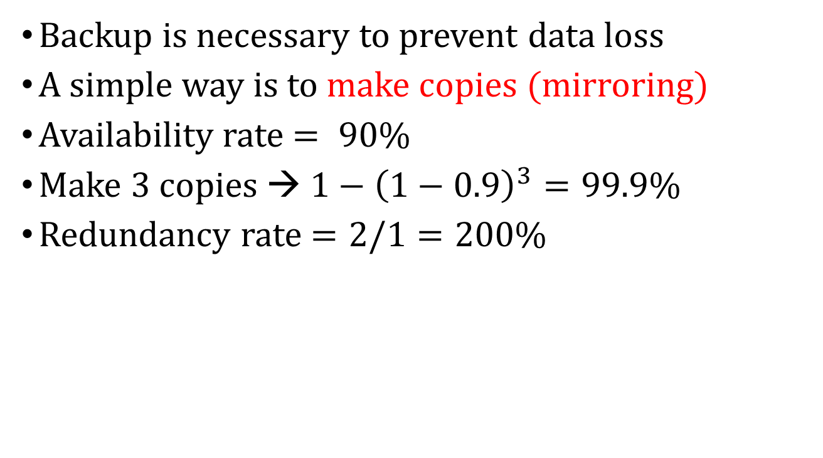
Data Availability
Backup is necessary to prevent data loss
A simple way is to make copies (mirroring)
Availability rate $= 90\%$
Make 3 copies → $1−{\left(1−0.9\right)}^{3}=99.9\%$
Redundancy rate $=2/1=200\%$

Slide 6
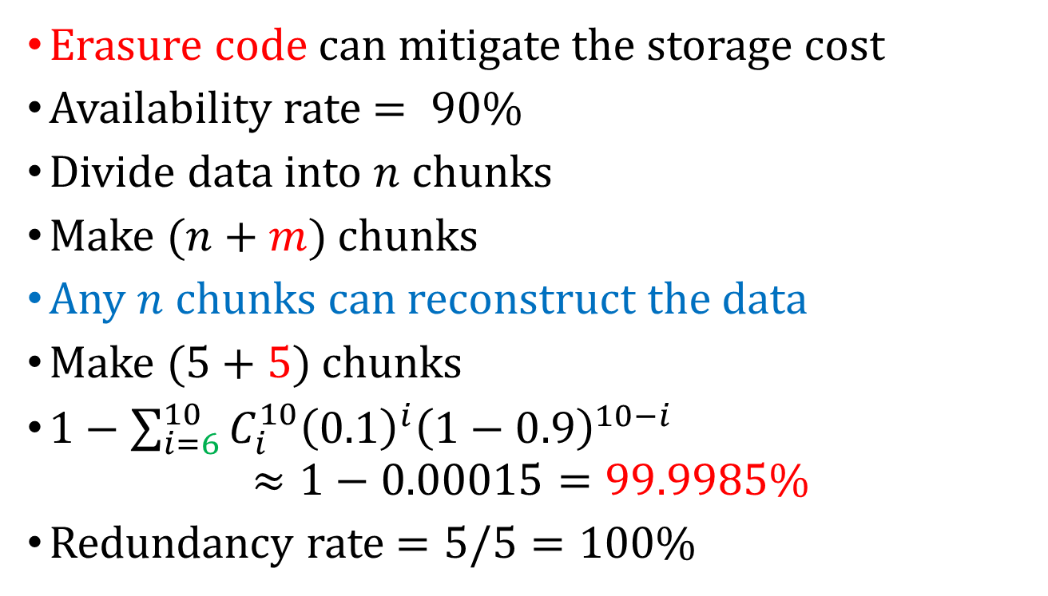
Data Availability – Erasure Code
Erasure code can mitigate the storage cost
Availability rate $= 90\%$
Divide data into $n$ chunks
Make $(n+m)$ chunks
Any $n$ chunks can reconstruct the data
Make $(5+5)$ chunks
$1−\sum_{i=6}^{10}{C_{i}^{10}{\left(0.1\right)}^{i}{\left(1−0.9\right)}^{10−i}}$ $≈1−0.00015=99.9985\%$
Redundancy rate $=5/5=100\%$

Slide 7
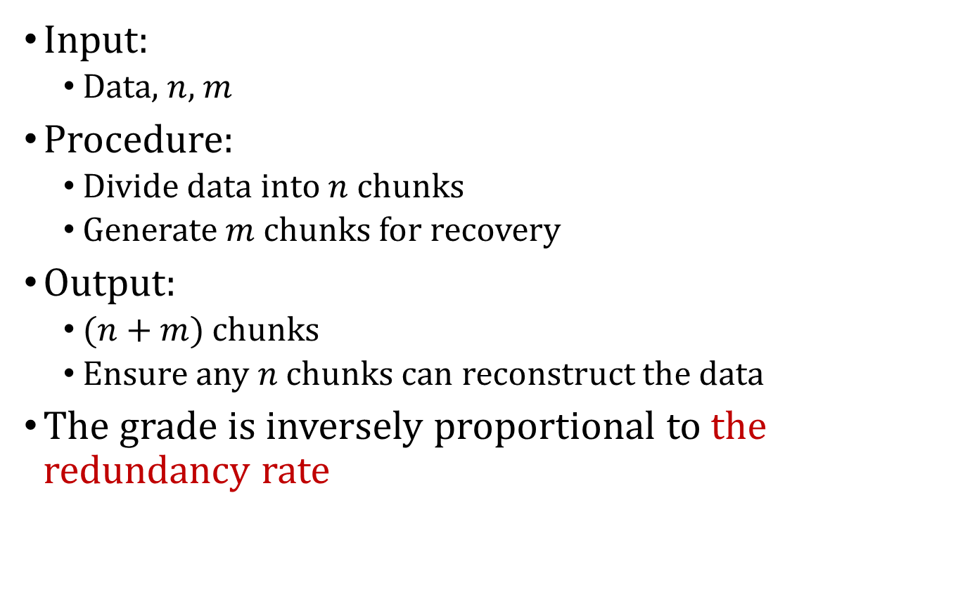
Programming Project #1: Design an erasure-code backup scheme
Input:
Data, $n$, $m$
Procedure:
Divide data into $n$ chunks
Generate $m$ chunks for recovery
Output:
$(n+m)$ chunks
Ensure any $n$ chunks can reconstruct the data
The grade is inversely proportional to the redundancy rate

Slide 8
Programming Project #1: Design an erasure-code backup scheme
Input:
Data, $n$, $m$
Procedure:
Divide data into $n$ chunks
Generate $m$ chunks for recovery
Output:
$(n+m)$ chunks
Ensure any $n$ chunks can reconstruct the data
The grade is inversely proportional to the redundancy rate
…

Slide 9
Programming Project #1: Design an erasure-code backup scheme
Input:
Data, $n$, $m$
Procedure:
Divide data into $n$ chunks
Generate $m$ chunks for recovery
Output:
$(n+m)$ chunks
Ensure any $n$ chunks can reconstruct the data
The grade is inversely proportional to the redundancy rate
怎麼辦

Slide 10
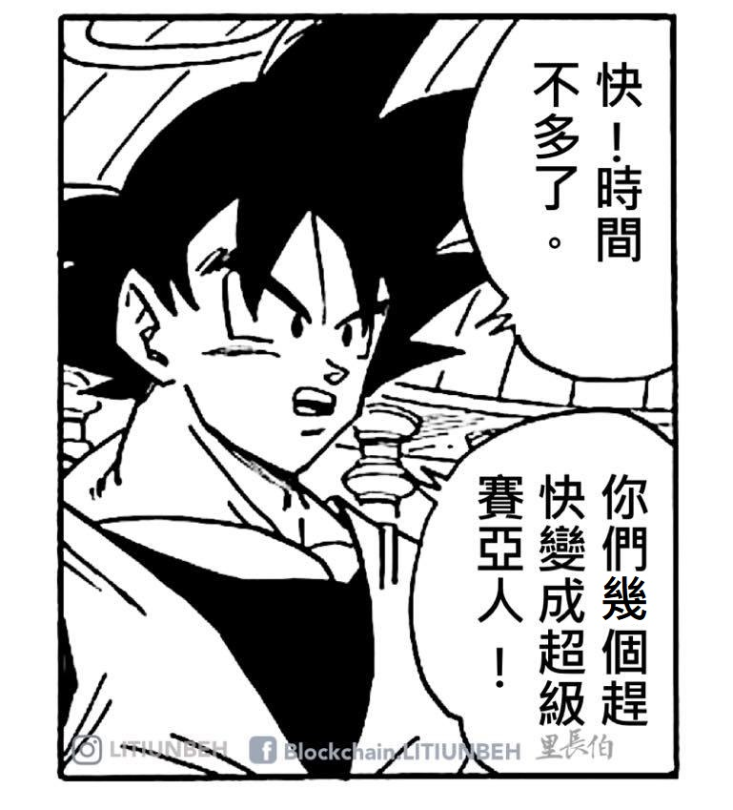
Programming Project #1: Design an erasure-code backup scheme
Input:
Data, $n$, $m$
Procedure:
Divide data into $n$ chunks
Generate $m$ chunks for recovery
Output:
$(n+m)$ chunks
Ensure any $n$ chunks can reconstruct the data
The grade is inversely proportional to the redundancy rate

Slide 11
Programming Project #1: Design an erasure-code backup scheme
Input:
Data, $n$, $m$
Procedure:
Divide data into $n$ chunks
Generate $m$ chunks for recovery
Output:
$(n+m)$ chunks
Ensure any $n$ chunks can reconstruct the data
The grade is inversely proportional to the redundancy rate
剛加簽就要棄選

Slide 12
Programming Project #1: Design an erasure-code backup scheme
Input:
Data, $n$, $m$
Procedure:
Divide data into $n$ chunks
Generate $m$ chunks for recovery
Output:
$(n+m)$ chunks
Ensure any $n$ chunks can reconstruct the data
The grade is inversely proportional to the redundancy rate
好啦不鬧

Slide 13
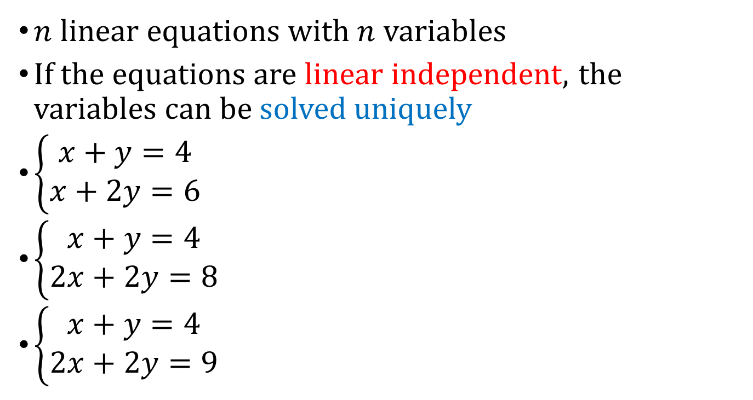
The Idea from System of Linear Equations
$n$ linear equations with $n$ variables
If the equations are linear independent, the variables can be solved uniquely
$\left\{\begin{aligned}x+y=4 \\ x+2y=6\end{aligned}\right.$
$\left\{\begin{aligned}x+y=4 \\ 2x+2y=8\end{aligned}\right.$
$\left\{\begin{aligned}x+y=4 \\ 2x+2y=9\end{aligned}\right.$
Notes:
Elementary row operations → identity matrix

Slide 14
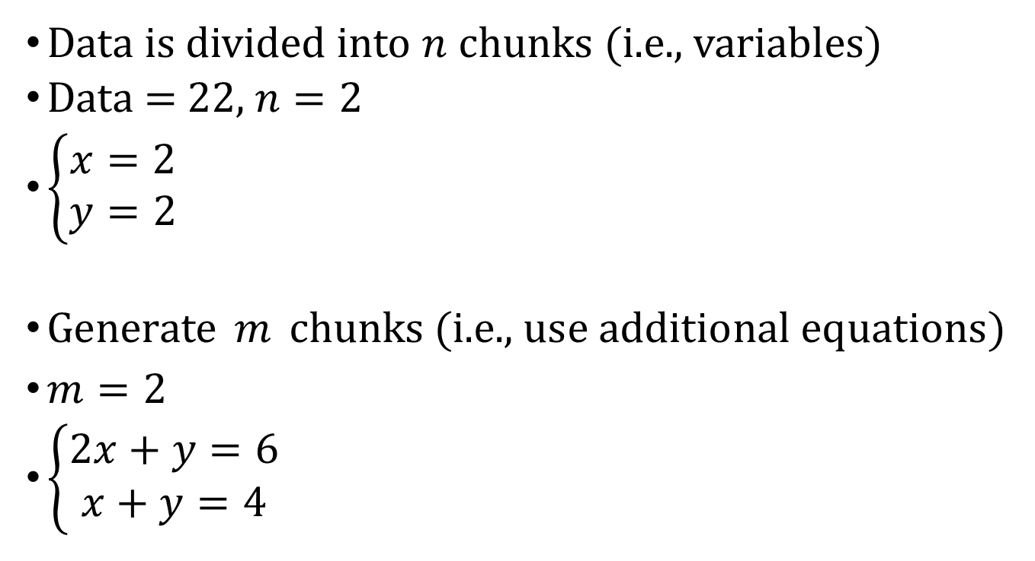
A Simple Erasure-Code Backup Scheme Encode
Data is divided into $n$ chunks (i.e., variables)
Data = 22, $n=2$
$\left\{\begin{aligned}x=2 \\ y=2\end{aligned}\right.$
Generate $m$ chunks (i.e., use additional equations)
$m=2$
$\left\{\begin{aligned}2x+y=6 \\ x+y=4\end{aligned}\right.$
Notes:
Elementary row operations → identity matrix

Slide 15
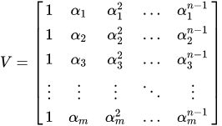
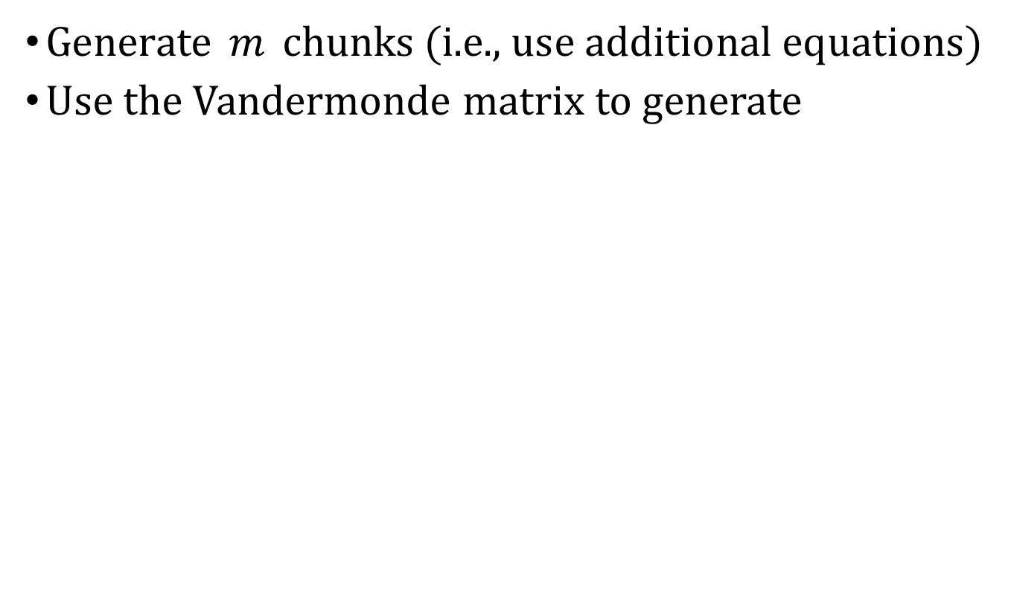

How to Generate the $m$ Equations
Generate $m$ chunks (i.e., use additional equations)
Use the Vandermonde matrix to generate
Notes:
Elementary row operations → identity matrix

Slide 16
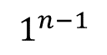
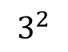
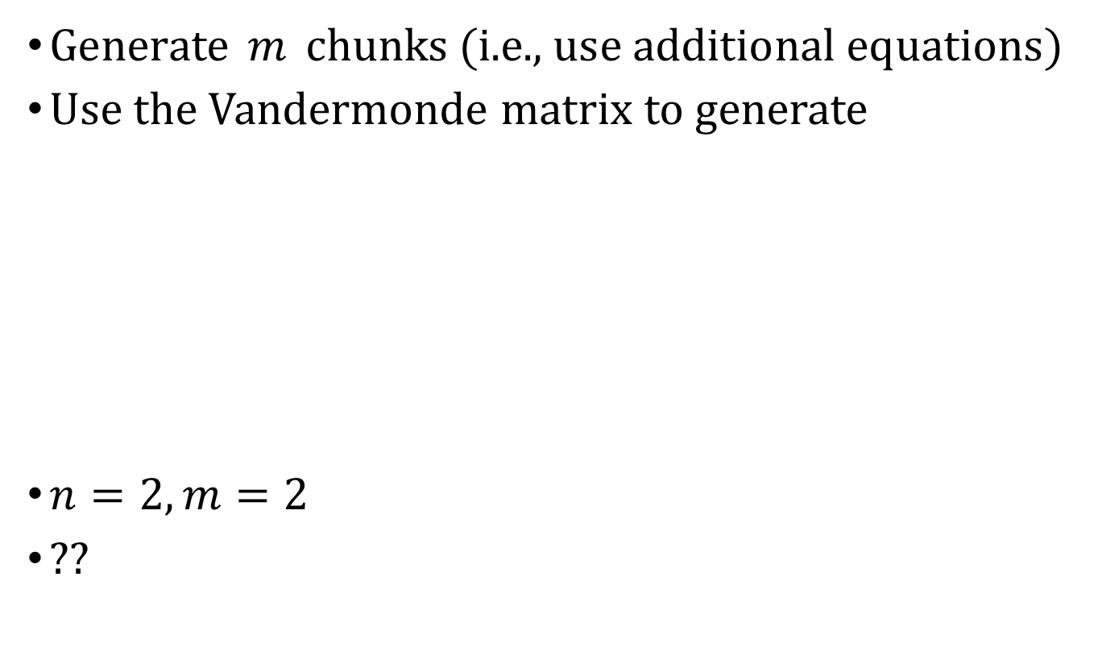
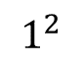
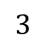
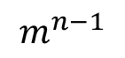
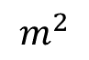

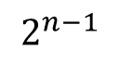
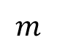
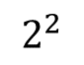
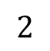
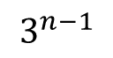
How to Generate the $m$ Equations
Generate $m$ chunks (i.e., use additional equations)
Use the Vandermonde matrix to generate
$n=2,m=2$
??
$$1$$
$$1^{2}$$
$$1^{n−1}$$
$$2$$
$$2^{2}$$
$$2^{n−1}$$
$$3$$
$$3^{2}$$
$$3^{n−1}$$
$$m$$
$$m^{2}$$
$$m^{n−1}$$
Notes:
Elementary row operations → identity matrix

Slide 17
How to Generate the $m$ Equations
Generate $m$ chunks (i.e., use additional equations)
Use the Vandermonde matrix to generate
$n=2,m=2$
??
$$1$$
$$1^{2}$$
$$1^{n−1}$$
$$2$$
$$2^{2}$$
$$2^{n−1}$$
$$3$$
$$3^{2}$$
$$3^{n−1}$$
$$m$$
$$m^{2}$$
$$m^{n−1}$$
Notes:
Elementary row operations → identity matrix

Slide 18
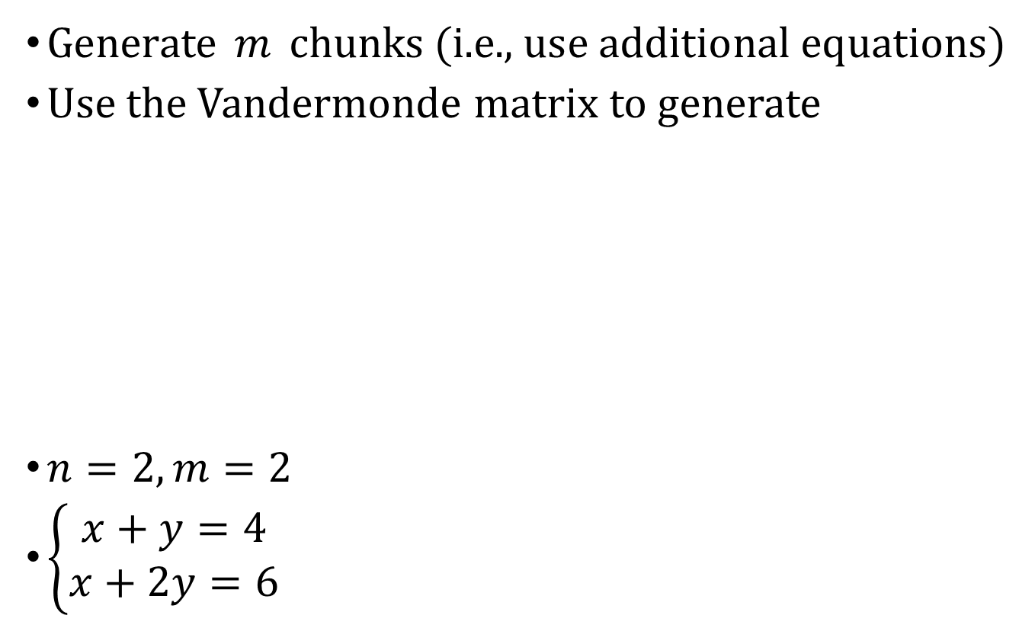
How to Generate the $m$ Equations
Generate $m$ chunks (i.e., use additional equations)
Use the Vandermonde matrix to generate
$n=2,m=2$
$\left\{\begin{aligned}x+y=4 \\ x+2y=6\end{aligned}\right.$
$$1$$
$$1^{2}$$
$$1^{n−1}$$
$$2$$
$$2^{2}$$
$$2^{n−1}$$
$$3$$
$$3^{2}$$
$$3^{n−1}$$
$$m$$
$$m^{2}$$
$$m^{n−1}$$
Notes:
Elementary row operations → identity matrix

Slide 19
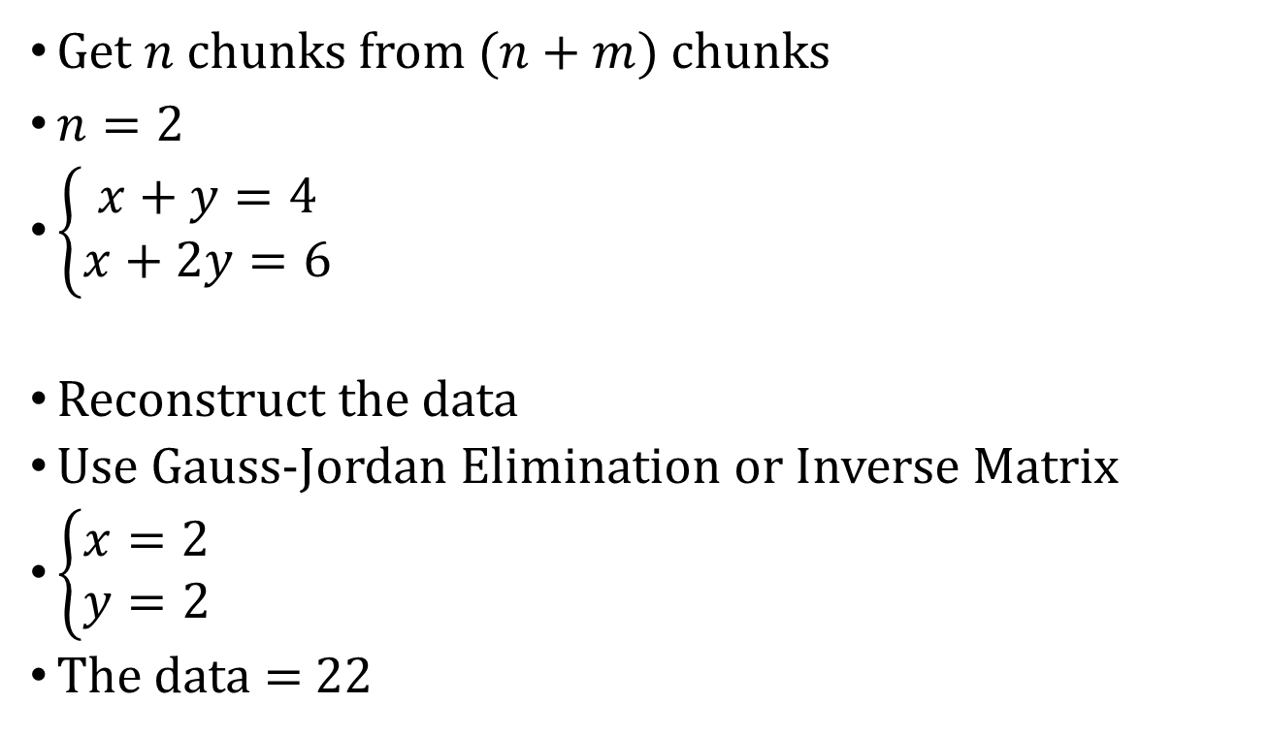
A Simple Erasure-Code Backup Scheme Decode
Get $n$ chunks from $(n+m)$ chunks
$n=2$
$\left\{\begin{aligned}x+y=4 \\ x+2y=6\end{aligned}\right.$
Reconstruct the data
Use Gauss-Jordan Elimination or Inverse Matrix
$\left\{\begin{aligned}x=2 \\ y=2\end{aligned}\right.$
The data = 22
Notes:
Elementary row operations → identity matrix

Slide 20
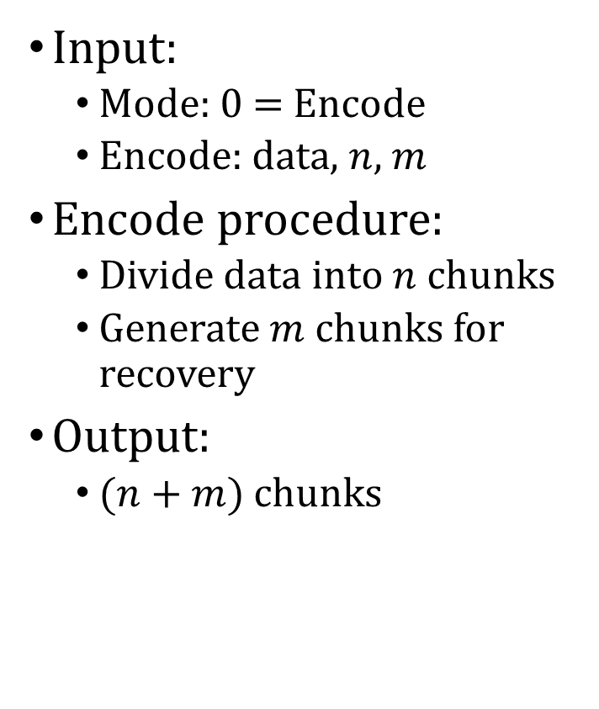
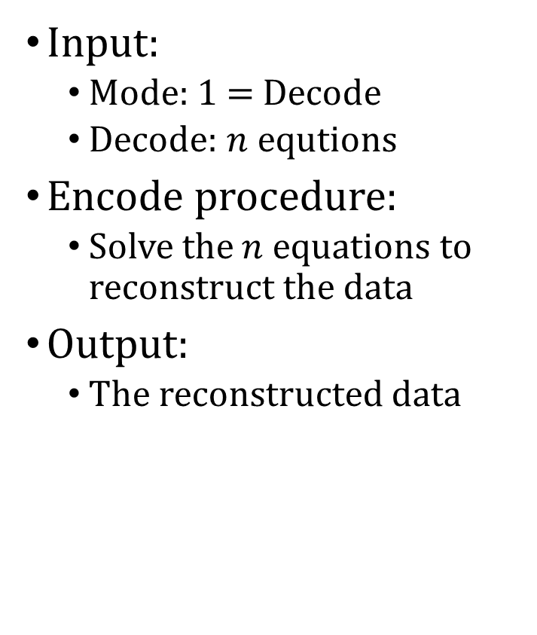
Programming Project #1: Implement a well-known erasure-code backup scheme
Input:
Mode: 0 = Encode
Encode: data, $n$, $m$
Encode procedure:
Divide data into $n$ chunks
Generate $m$ chunks for recovery
Output:
$(n+m)$ chunks
Input:
Mode: 1 = Decode
Decode: $n$ equtions
Encode procedure:
Solve the $n$ equations to reconstruct the data
Output:
The reconstructed data

Slide 21
Input Sample: use scanf
Format:
Mode n m
InputString
Format:
Mode n
n_Equations
Exampe:
0 2 2
22
Exampe:
1 2
1 1 4
1 2 6

Slide 22
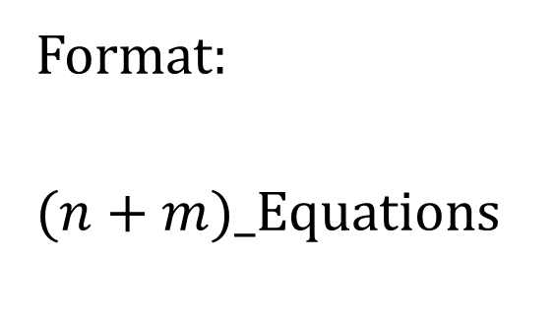
Output Sample: use printf
Format:
$(n+m$)_Equations
Format:
Data
Example:
1 0 2
0 1 2
1 1 4
1 2 6
Example:
22

Slide 23
Note
Superb deadline: 10/19 Tue
Deadline: 10/26 Tue
Pass the test of our online judge platform
Submit your code to E-course2
Demonstrate your code remotely with TA
C Source code (i.e., only .c)
Show a good programming style

Slide 24
Further Reading
An ensemble of replication and erasure codes for cloud file systems, IEEE INFOCOM 2013
Fast Erasure Coding for Data Storage: A Comprehensive Study of the Acceleration Techniques, ACM FAST 2019
…

